Slide 1
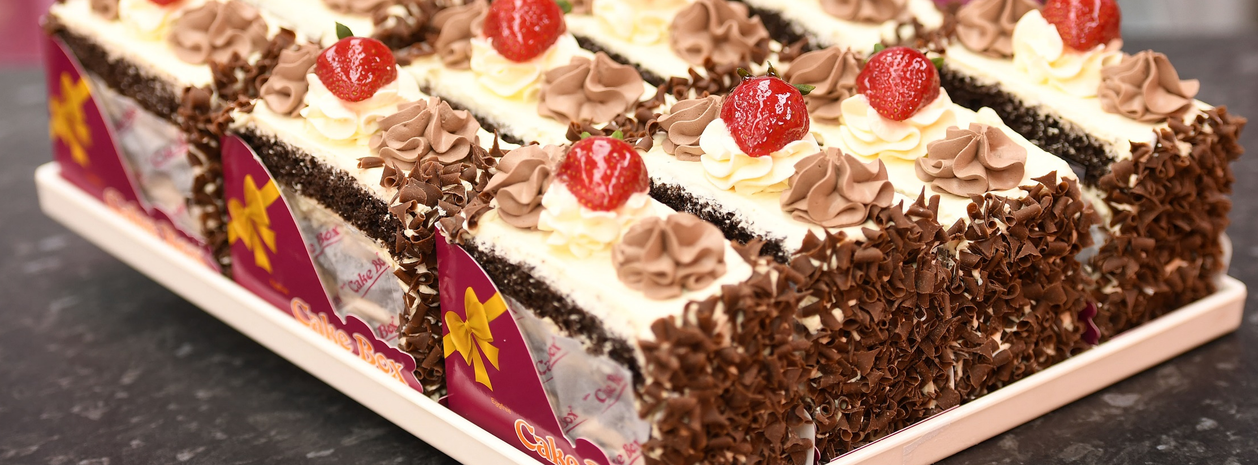
Final results presentation for
the half year to 30th September 2019
Results presentation
for the six months to 30th September 2020

Slide 2

Your Presenters Today
Sukh Chamdal Chief Executive Officer
Opened the first Cake Box concept store in 2008, co-founded the franchise business in 2009
35+ years’ experience in the food manufacturing and the food retail industry
Consultant for a food equipment company specialising in high volume food production
Previously owned a food catering company supplying vegetarian food for functions and events
Pardip Dass Chief Financial Officer
Co-founded the Cake Box franchise business in 2009
Qualified Accountant (10+ years PQE)
15+ years’ experience within the food and beverage industry
Previously worked for Starbucks, Masala Zone, Group Chez Gerard Restaurants and Real Pubs where he was Finance Director
Proven management team supported
by a highly experienced board

Slide 3
Financial Highlights
REVENUE | GROSS PROFIT | EBITDA
£8.59m | £4.16m | £1.98m
-2.1% | +5.3% | +0.5%
YEAR-ON-YEAR | YEAR-ON-YEAR | YEAR-ON-YEAR
UNDERLYING EPS | NET CASH | INTERIM DIVIDEND
3.45 | £3.8m | 1.85p
+6.0% | up £2.3m | +15%
(H1 FY20: 3.67p) | (H1 FY20: £1.5m) | (H1 FY20: 1.6p)

Slide 4
Operational Highlights
6 |  | 139 |  | 5 |  | DELIVERY |  | NEW PRODUCTS
NEW STORES OPENED |  | TOTAL NUMBER OF STORES |  | NEW STORES POST PERIOD END |  | CAKE BOX HOME DELIVERY LAUNCHED |  | GLUTEN FREE AND VEGAN LOAF CAKES
All stores closed late March to Mid May - 6 weeks in total of disrupted sales
Six new franchise stores added in the period (H1 FY20: 9 new stores)
139 franchise stores operating by 30 September 2020
Five new stores opened post period end
Launch of Cake Box home delivery service to complement our existing partner offer
Successful launch of new product ranges, including gluten free and vegan loaf cakes
New Coventry warehouse and distribution facility nearing completion and expected to open during the second half of the year

Slide 5
Franchisee Operational Highlights
£17.1m |  | 51% |  | 12.1% |  | 32 |  | £87k
RETAIL CAKE SALES |  | ONLINE SALES GROWTH |  | LIKE-FOR-LIKE** GROWTH SINCE REOPENING |  | NUMBER OF MULTIPLE FRANCHISEES |  | AVERAGE STORE EBITDA*
Franchisee total turnover down 1.7% to £17.1m (H1 FY20: £17.8m), reflecting six week period of store closures
Online sales up 51% to £4.00m (H1 FY20: £2.64m)
Like-for-like sales up +12.1% in the 20 weeks to 30 September following reopening of the store estate in May (H1 FY20: +6.9%)**
32 franchisees have more than one store (H1 FY20: 24)
Our average franchisee earns in excess of £87k pa EBITDA (FY20 £82K, H1 FY20 £88k)*
Strong pipeline of potential new franchisees and existing ones looking for additional stores
*Based on mature stores - “mature store” defined as store that has been open for 12 months or longer
** Like-for-like: Stores trading for at least one full financial year prior to 30th September 2020

Slide 6
A Rapidly Growing Portfolio of Franchise Stores
139
STORES
NATIONWIDE
AND
14
KIOSK
LOCATIONS
Area | Stores | Kiosks
London within M25 | 50 | 2
North East | 3 | 1
North West | 8 | 3
Yorkshire | 9 | 3
East Midlands | 14 | 0
West Midlands | 20 | 0
South East | 33 | 5
Wales | 1 | 0
Scotland | 1 | 0
Total | 139 | 14

Slide 7
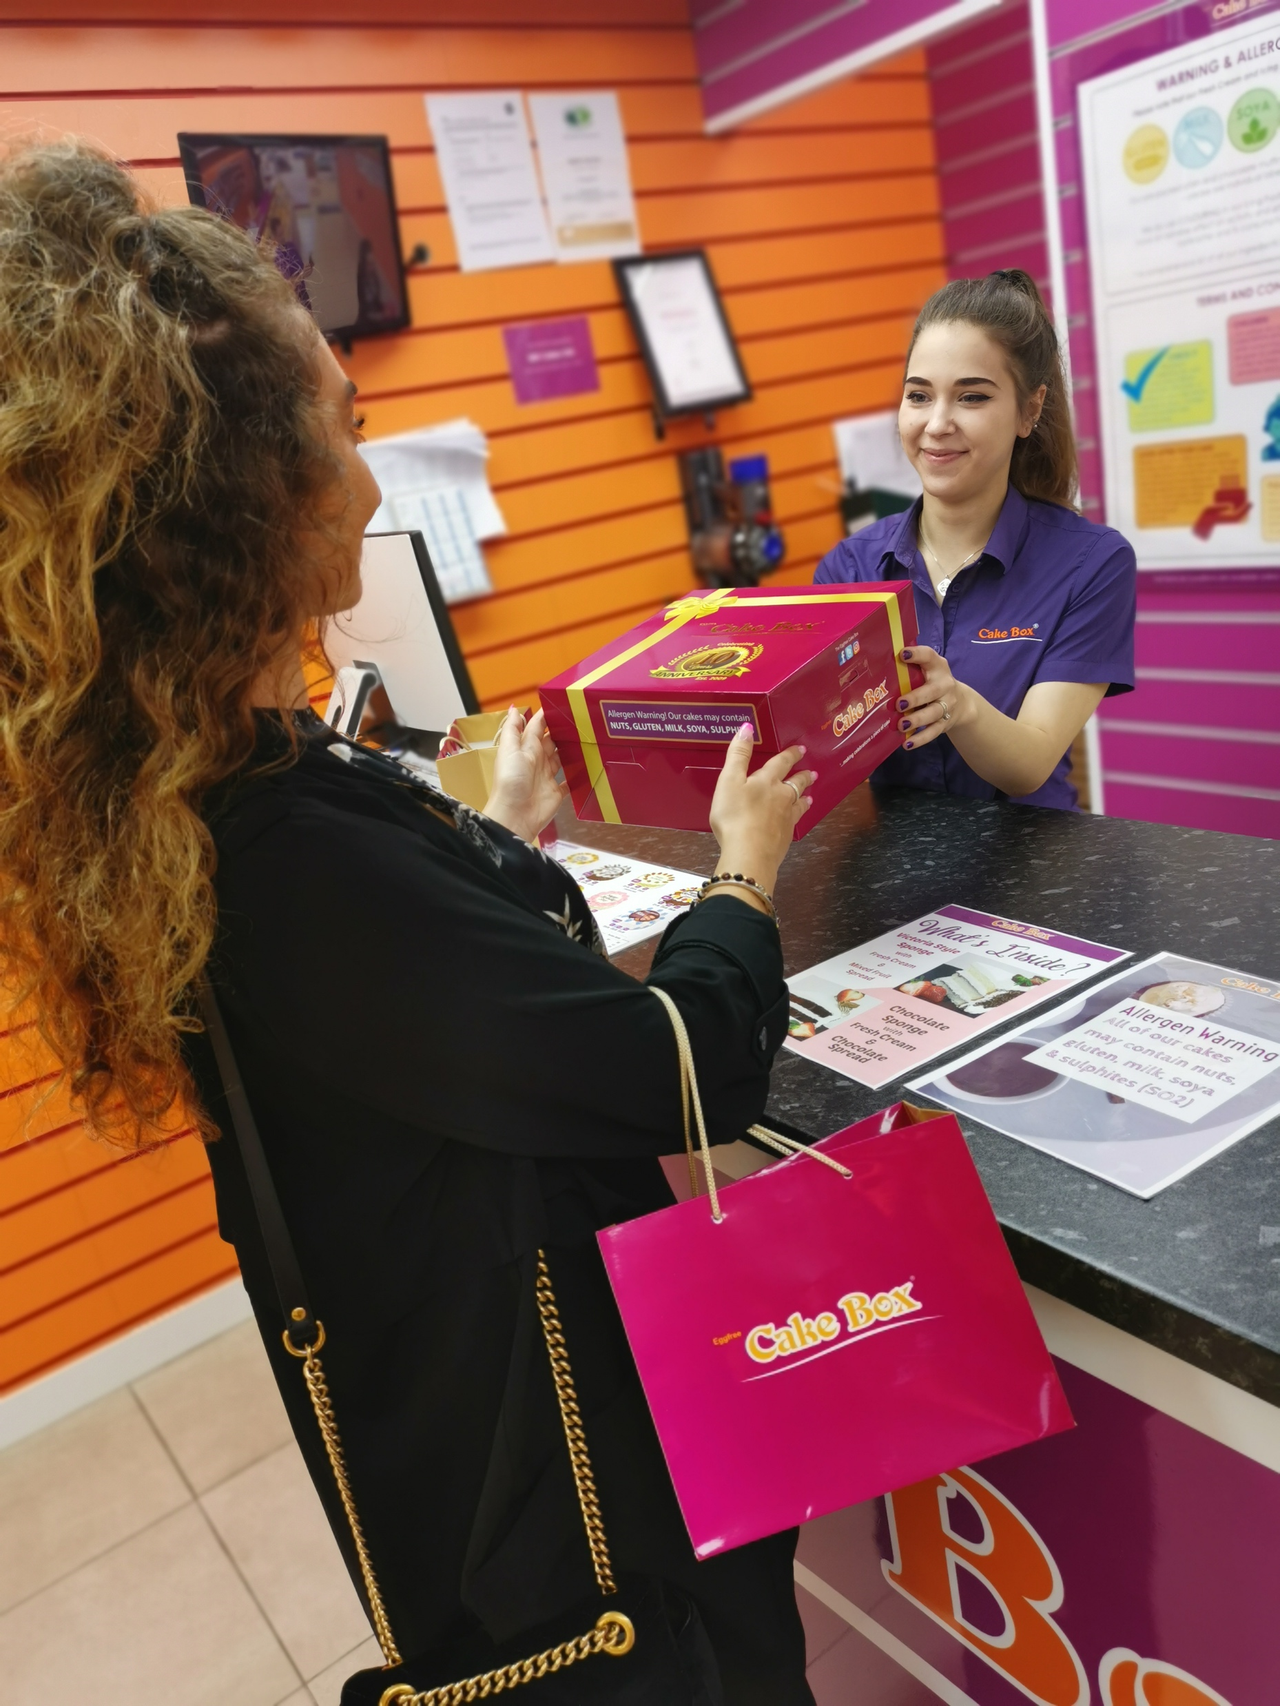
Financial Review

Slide 8
Group Income Statement
 | 6 months to 30 September 2020 |  | 6 months to 30 September 2019 |  | 12 months to 31 March 2020
 | (unaudited) |  | (unaudited) |  | (audited) |  | Notes
 | £k |  | £k |  | £k
Revenue | 8,587 |  | 8,767 |  | 18,742 |  | Revenue drop of 2% Year-on-Year due to six-week closure of all sites
Cost of sales | (4,431) |  | (4,816) |  | (9,979)
Gross profit | 4,155 |  | 3,951 |  | 8,764 |  | Gross margin improved to 45.0% from 48.4%
Administrative expenses | (2,470) |  | (2,185) |  | (4,972) |  | Increased costs in payroll due to planned growth in management team
Other operating income | - |  | - |  | 9
Operating profit | 1,685 |  | 1,766 |  | 3,800
Net finance costs | (20) |  | (25) |  | (36)
Profit before tax | 1,665 |  | 1,741 |  | 3,764
Corporation Tax | (286) |  | (272) |  | (635)
PROFIT AFTER TAX | 1,380 |  | 1,468 |  | 3,129 |  | Drop in profit due to revenue impact as a result of store closures in March/April
EARNINGS PER SHARE
Basic & diluted | 3.45p |  | 3.67p |  | 7.82p
Adjusted | 3.45p |  | 3.67p |  | 7.74p

Slide 9
Group Balance Sheet
 | 30-Sep-2020 | 30-Sep-2019 |  | 31-Mar-2020
 | (Unaudited) | (Unaudited) |  | (audited)
 |  |  |  |  |  | Notes
ASSETS | £k | £k |  | £k
Non-current assets | 7,224 | 5,576 |  | 7,247 |  | Revaluation uplift from H1 FY20
Inventories | 1,370 | 1,153 |  | 1,396
Trade and other receivables | 1,603 | 1,570 |  | 1,453
Cash and cash equivalents | 5,336 | 3,224 |  | 3,676 |  | Cash improved by lack of FY dividend and lower capex
Current assets | 8,309 | 5,947 |  | 6,526
TOTAL ASSETS | 15,533 | 11,523 |  | 13,773
Current liabilities | (3,901) | (2,700) |  | (2,310) |  | Includes accrual of special dividend of £1.28m
Non-current liabilities
Borrowings | (1,371) | (1,506) |  | (1,446)
Deferred tax liabilities | (532) | (121) |  | (532)
 | (1,904) | (1,627) |  | (1,979)
NET ASSETS | 9,729 | 7,197 |  | 9,484
Issued share capital | 400 | 400 |  | 400
Revaluation reserve | 1,589 | 455 |  | 1,788
Share Option reserve | 343 | 65 |  | 0
Retained earnings | 7,396 | 6,276 |  | 7,297
SHARE CAPITAL AND RESERVES | 9,729 | 7,197 |  | 9,484

Slide 10
Group Cash Flow
 | 30-Sep-2020 | 30-Sep-2019 | 31-Mar-2020
 | (Unaudited) | (Unaudited) | (audited)
 |  |  |  |  | Notes
 | £k | £k | £k
Cash from operating activities:
Profit before income tax | 1,665 | 1,741 | 3,764
Adjusted for:
Non-cash items | 816 | 583 | 65
Cash generated by operations | 2,481 | 2,323 | 3,829
Finance costs | 22 | 33 | 54
Grant of share options | 145 | 54 | 198
Taxation paid | (652) | (557) | (728)
Net cash inflow from operating activities | 1,995 | 1,853 | 3,354
Net cash flows used in investing activities | (239) | (242) | (570)
Cash flows from financing activities:
Dividends paid | 0 | (960) | (1,600)
Other | (97) | (509) | (590) |  | Comparable period included sale and purchase of property
Net cash flows used in financing activities | (97) | (1,469) | (2,190)
Net (decrease)/increase in cash and cash equivalents | 1,660 | 142 | 594
Cash and cash equivalents brought forward | 3,676 | 3,082 | 3,082
Cash and cash equivalents carried forward | 5,336 | 3,224 | 3,676

Slide 11
Strategic Initiatives

Slide 12
Store Rollout
Store rollout
Record number of new franchisee deposits with increased geographical presence from new distribution centres
Key:
Distribution Centres
Bradford
Coventry
Enfield
47 Potential Franchisees

Slide 13



Home Delivery
Spring lockdown
End of school holidays
Second lockdown
Incremental growth opportunity from delivery platforms and own delivery network

Slide 14
Current Trading and Outlook

Slide 15
Current Trading and Outlook
Strong like-for-like* sales momentum
Stores remain open, majority of shopping centre kiosks closed
Positive sales growth maintained in H2 despite second lockdown
Online sales up c.56.5% YoY in the six weeks since period end - boosted by launch of the Cake Box home delivery
Five new stores opened since the period end
Strong pipeline of new franchisees and franchise stores
Confident of meeting full year opening target of new stores and delivery of growth strategy
Second lockdown
“With a strong balance sheet and unique proposition, we remain confident of making continued progress in the second half”
* Like-for-like: Stores trading for at least one full financial year prior to 30 September 2020

Slide 16
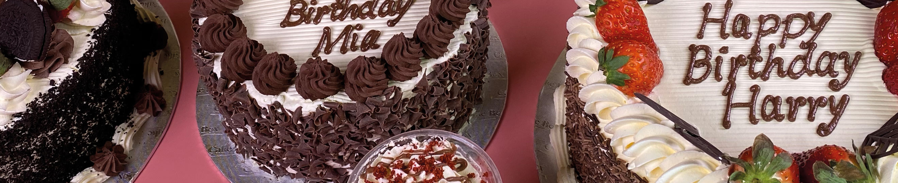
Q&A

Slide 17
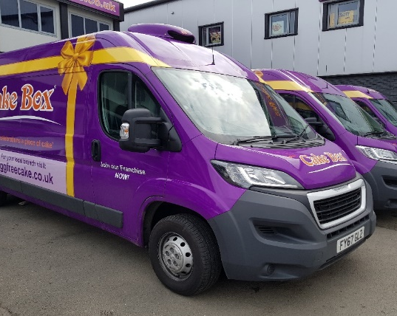
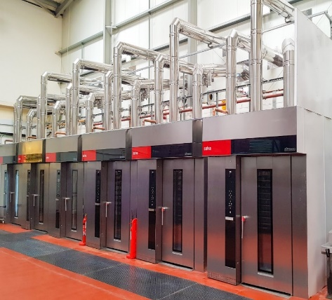
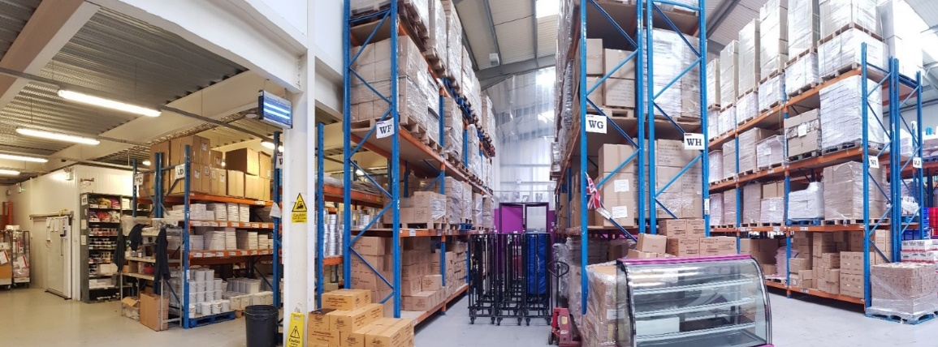
Appendix

Slide 18
An attractive investor proposition
        Proven model and track record of profitable growth
        Strong financial track record
        History of steady and profitable expansion
        Strong like-for-like* growth – H1 FY21 +12.1% (20 weeks to 30th Sep 2020 after COVID-19 impact)
        Significant number of potential locations for new stores identified
        Minimal capital required for expansion due to franchise model
        Very attractive proposition for franchisees
        New products including gluten & vegan loaf cakes
        Significant scope for expansion
        Limited Competition
        No direct national competitor for egg-free, fresh cream, personalised cakes
        Strong and predictable cash flow generation from low risk franchise model
        A progressive dividend policy which reflects the cash flow generation
        and earnings of the Group
        Strong income credentials
Low risk income with strong growth potential funded by franchisees
* Like-for-like: Stores trading for at least one full financial year prior to 30th September 2020

Slide 19
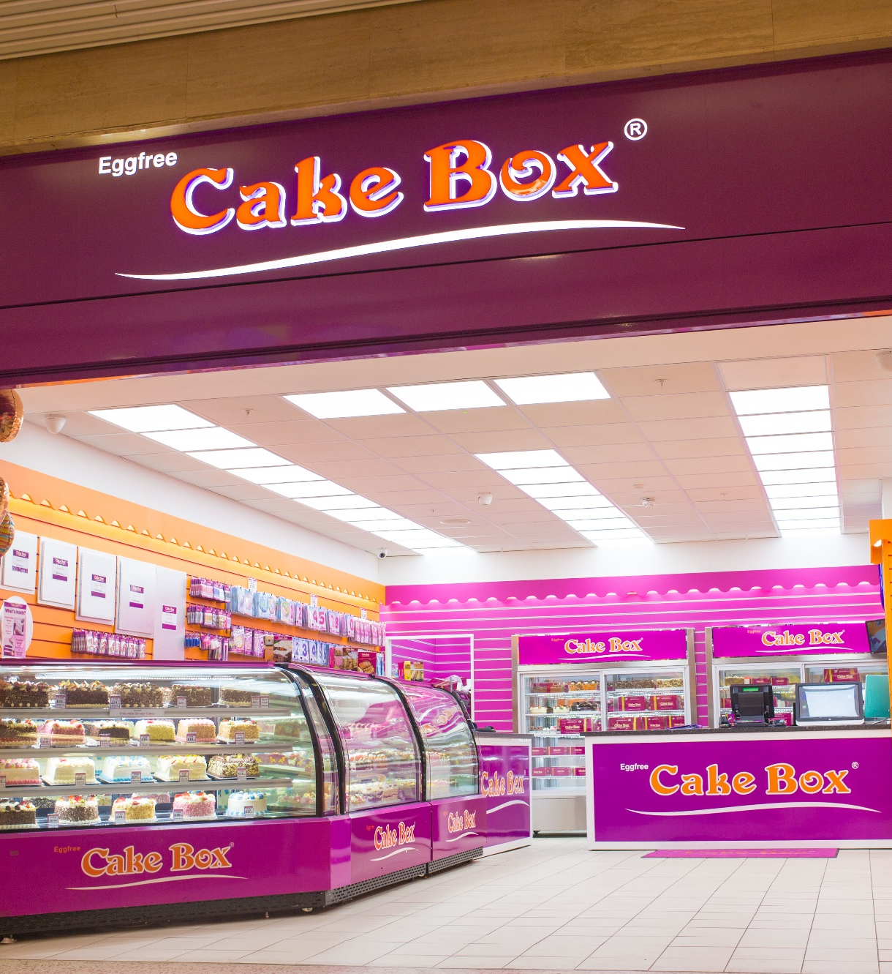
Introduction to Cake Box
FIRST STORE
OPENED IN 2008
Business conceived in 2008 with a single shop in East London, now headquartered in Enfield, Greater London
139 franchise stores as at 30th September 2020
Specialises in making delicious, high quality, bespoke celebration fresh cream cakes in-store while customers wait
All of our cakes are free from egg products
Personalisation offered even while you wait
One hour available for popular cakes
Strong growth profile

Slide 20

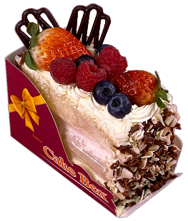


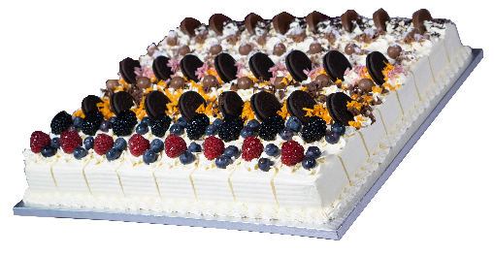
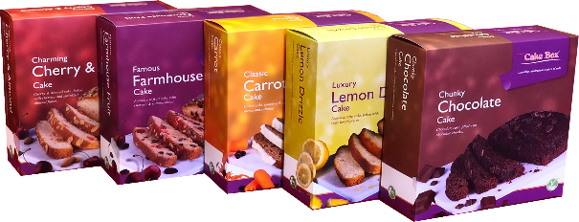
Our products
Fruit Gateaux
Serves 8
£20.99
Freshly hand-made cakes and slices in-store using fresh cream
Cakes available to order in-store or online for collection
Hundreds of celebration cake designs to choose from
Cakes can be personalised on the spot with a free message
Personalised photos printed on sugar paper can be added to any cake
Large range of cakes for immediate purchase from patisserie displays
Large selection of cake sizes ranging from 8 to 120 servings per cake
Individual hand made cake slices start from only £2.50
Cake Slice
Serves 1-2
From £2.50
Cheesecakes
Serves 8
£8.99
Cupcakes
From £1.50
Platter Cake
Serves 64
From £69.99
Loaf Cake
420g Serves 4-6
£4.99

Slide 21
An attractive franchisee proposition
Potential
To own multiple sites
Earnings
Average EBITDA £87k pa*
No MSF or
Marketing Levy
Brand
Access to the Cake Box Know how
Sociable Hours
Website
Managed Website and Online ordering system
20 Month Payback on Average
B2B
One stop ordering
Turnkey Package
*Based on mature stores - “mature store” defined as store that has been open for 12 months or longer

Slide 22
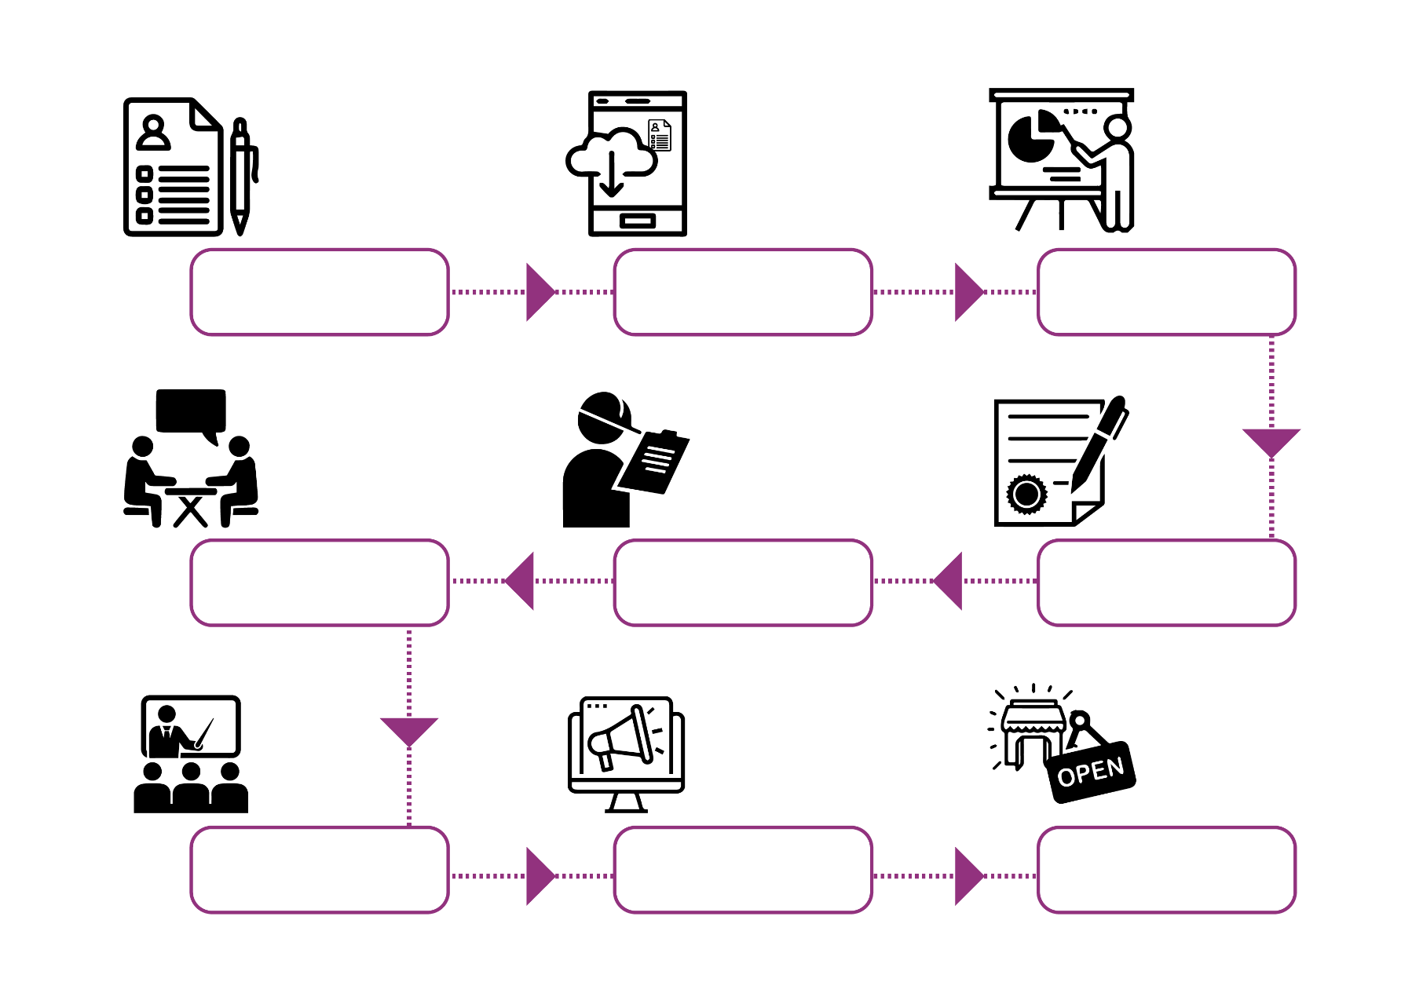
Store Franchise Application Process
A professional & seamless operation from start to finish.
Online Application
Received & Reviewed
Full Franchise
Application Sent
Successful Application
Invited To Presentation
Legals
Site Selection
Second Interview
Store Build & Training
Pre-open Marketing
Store Open

